Slide 1
4.4 Itô-Doeblin Formula
報告人：
0253924張錦炘
0253926沈宣佑

Slide 2
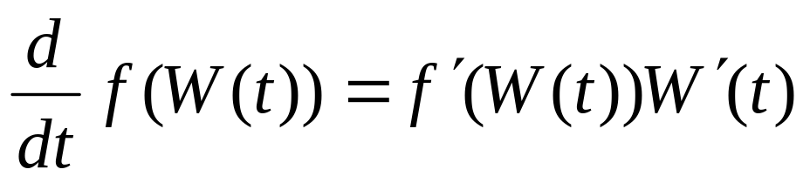
4.4.1 Formula for Brownian motion
We want a rule to “differentiate” expressions of the form f(W(t)), where f(x) is a differentiable function and W(t) is a Brownian motion. If W(t) were also differentiable, than the chain rule from ordinary calculus would give

Slide 3

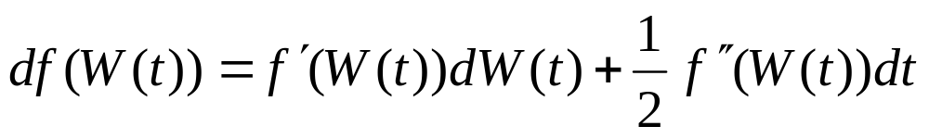
Which could be written in differential notation as
Because W has nonzero quadratic variation, the correct formula has an extra term,
(4.4.1)
This is the Itô-Doeblin Formula in differential form.

Slide 4
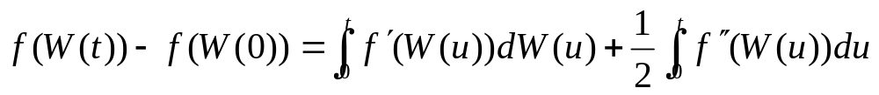
Integrating this, we obtain the Itô-Doeblin Formula in integral form
(4.4.2)
The mathematically meaningful form of the Itô-Doeblin Formula is the integral form (4.4.2).

Slide 5
For pencil and paper computations, the more convenient form of the Itô-Doeblin Formula is the differential form.
The intuitive meaning is that
  df(W(t)) is the change in f(W(t)) when t changes a “little bit” dt
  d(W(t)) is the change in the Brownian motion when t changes a “little bit” dt
  And the whole formula is exact only when the “little bit” is “infinitesimally small.” Because there is no precise definition for “little bit” and “infinitesimally small,” we rely on (4.4.2) to give precise meaning to (4.4.1).

Slide 6
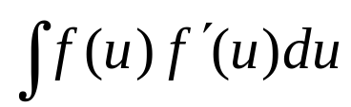
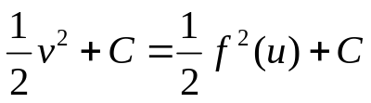
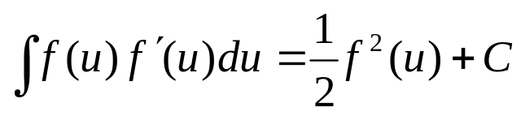
The relationship between (4.4.1) and (4.4.2) is similar to that developed in ordinary calculus to assist in changing variables in an integral.
Compute
Let v=f(u), and write dv=f’(u)du, so that the indefinite integral becomes ∫vdv, which is
where C is a constant of integration.
The final formula
is correct, as can be verified by differentiation.

Slide 7
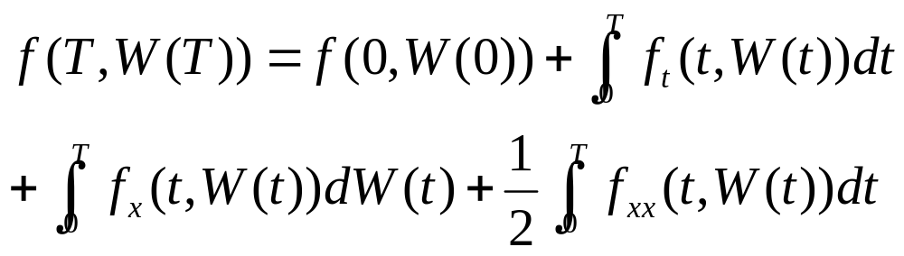
Theorem 4.4.1
(Itô-Doeblin formula for Brownian motion)
Let f(t,x) be a function for which the partial derivatives f_{t}(t,x), f_{x}(t,x), and f_{xx}(t,x) are defined and continuous, and let W(t) be a Brownian motion. Then, for every T>=0,

Slide 8
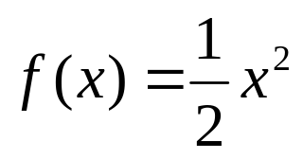

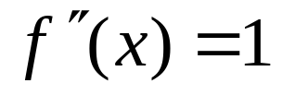
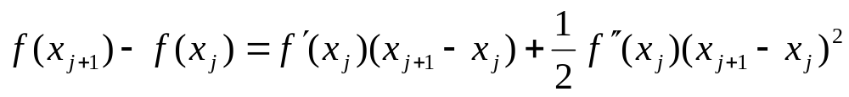
Theorem 4.4.1
(Itô-Doeblin formula for Brownian motion)
Sketch of Proof :
First we show why it holds when
In this case, and
Taylor’s formula implies
In this case, Taylor’s formula to second order is exact (there is no remainder term)
  Because f’’’ and all higher derivatives of f are zero.

Slide 9
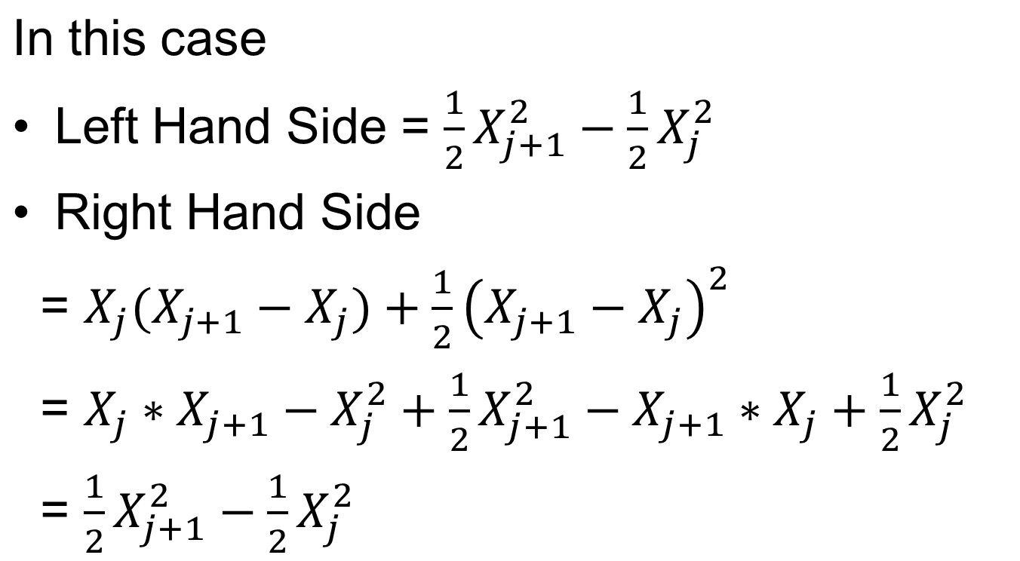

Slide 10
Theorem 4.4.1
(Itô-Doeblin formula for Brownian motion)
Fix T>0, and let ∏={t₀, t₁, …, t_{n}} be a partition of [0, T] (i.e., 0=t₀<t₁<…<t_{n}=T).
We are interested in the difference between f(W(0)) and f(W(T)).
This change in f(W(t)) between times t=0 and t=T can be written as sum of the changes in f(W(t)) over each of the subintervals [t_{j},t_{j+1}].

Slide 11
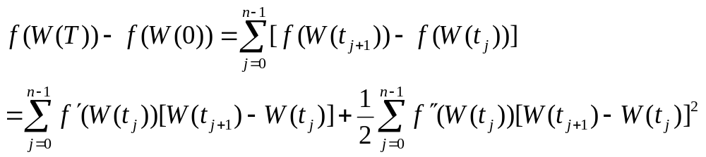
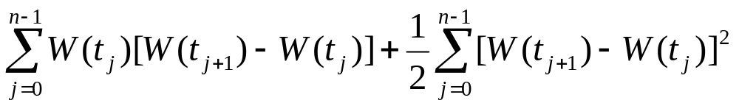
Theorem 4.4.1
(Itô-Doeblin formula for Brownian motion)
We do this and then use Taylor’s formula with x_{j}=W(t_{j}) and x_{j+1}=W(t_{j+1}) to obtain
(4.4.5)
For the function ,the right-hand side is
(4.4.6)

Slide 12
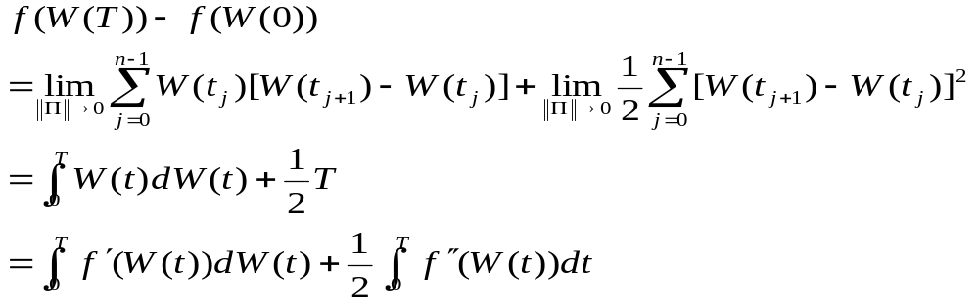
Theorem 4.4.1
(Itô-Doeblin formula for Brownian motion)
If we let ||∏||→0, the left-hand side of (4.4.5) is unaffected and the terms on the right-hand side converge to an Itô integral and one-half of the quadratic variation of Brownian motion, respectively:
(4.4.7)
This is the Itô-Doeblin formula in integral form for the function

Slide 13
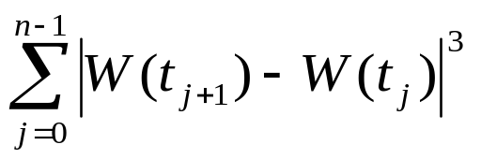
Theorem 4.4.1
(Itô-Doeblin formula for Brownian motion)
If we had a general function f(x), then in (4.4.5) we would have also gotten a sum of terms containing [W(t_{j+1})-W(t_{j})]³ .
But according to Exercise 3.4 Chapter 3 (pp118, (ii)) has limit zero as ||∏||→0
Therefore, this term would make no contribution to the final answer.

Slide 14
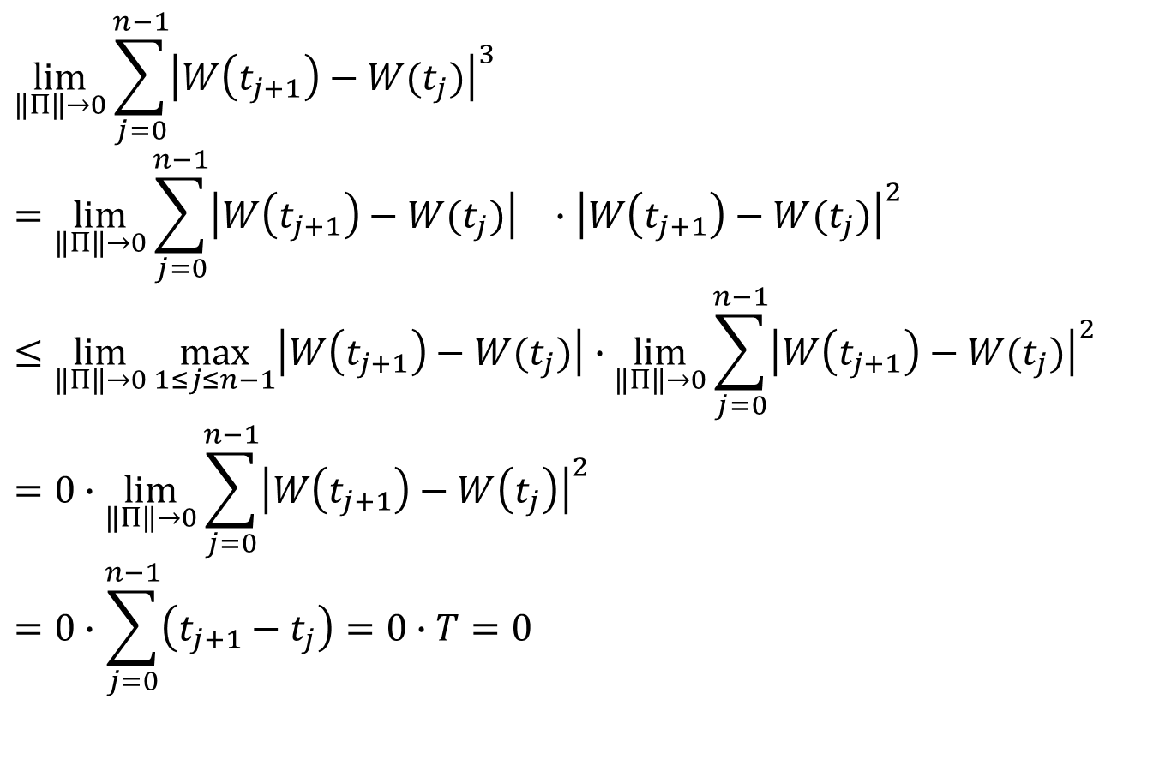

Slide 15
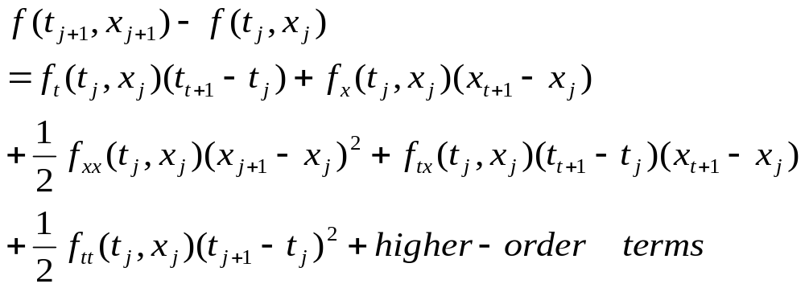
Theorem 4.4.1
(Itô-Doeblin formula for Brownian motion)
If we take a function f(t,x) of both the time variable t and the variable x, then Taylor’s Theorem says that

Slide 16
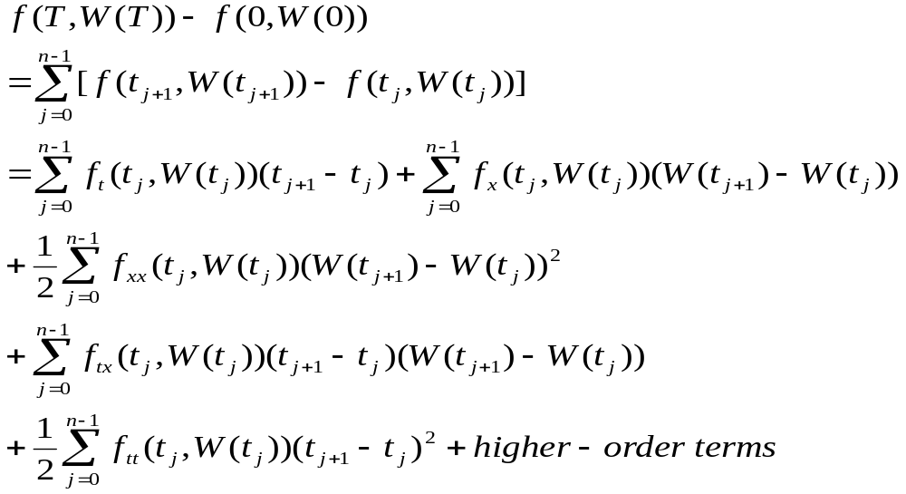
Theorem 4.4.1
(Itô-Doeblin formula for Brownian motion)
We replace x_{j} by W(t_{j}), replace x_{j+1} by W(t_{j+1}), and sum:
(4.4.9)

Slide 17
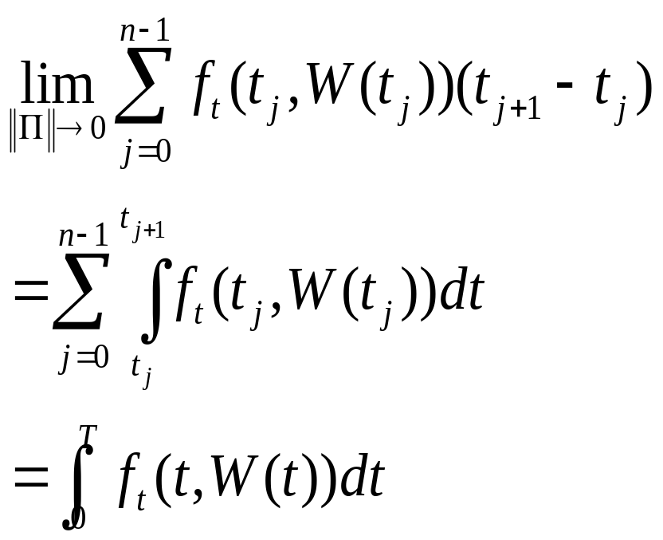
Theorem 4.4.1
(Itô-Doeblin formula for Brownian motion)
When we take the limit as ||∏||→0, the left-hand side of (4.4.9) is unaffected.
The first term on the right-hand side of (4.4.9) contributes the ordinary integral

Slide 18
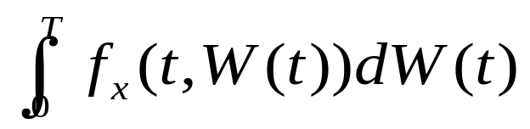
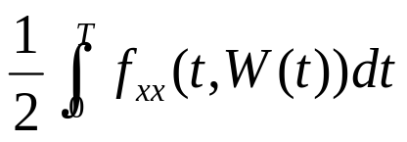
Theorem 4.4.1
(Itô-Doeblin formula for Brownian motion)
As ||∏||→0, the second term contributes the Itô integral
The third term contributes
  We can replace (W(t_{j+1})-W(t_{j}))² by t_{j+1}-t_{j}
  This is not an exact substitution, but when we sum the terms this substitution gives the correct limit as ||∏||→0.
These limits of the first three terms appear on the right-hand side of Theorem formula.

Slide 19
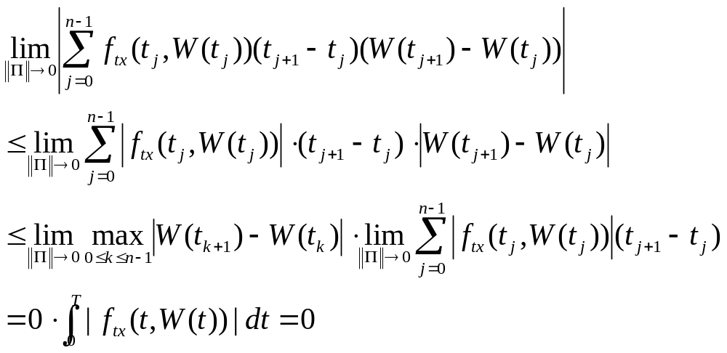
Theorem 4.4.1
(Itô-Doeblin formula for Brownian motion)
The fourth and fifth terms contribute zero.
For the fourth term, we observe that
(4.4.10)
Because partial derivatives are defined and continuous, so the integral exists.

Slide 20
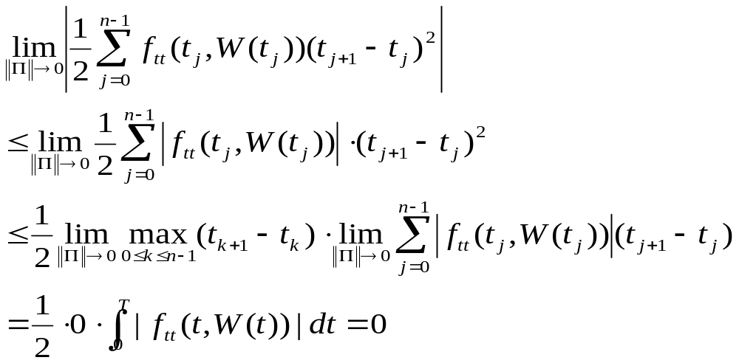
Theorem 4.4.1
(Itô-Doeblin formula for Brownian motion)
The fifth term is treated similarly:
(4.4.11)
The higher-order terms likewise contribute zero to the final answer.
Because partial derivatives are defined and continuous, so the integral exists.

Slide 21
Remark 4.4.2
The fact that the sum (4.4.10) of terms containing the product (t_{j+1}-t_{j})(W(t_{j+1})-W(t_{j})) has limit zero can be informally recorded by the formula dtdW(t)=0.
Similarly, the sum (4.4.11) of terms containing (t_{j+1}-t_{j})² also has limit zero, and this can be recorded by the formula dtdt=0.

Slide 22
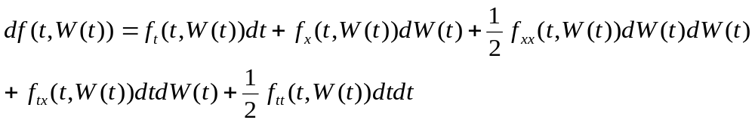
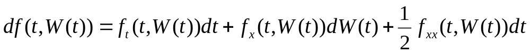
Remark 4.4.2
We can write these terms if we like in the Itô-Doeblin formula, so that in differential form it becomes
But
And the Itô-Doeblin formula in differential form simplifies to

Slide 23
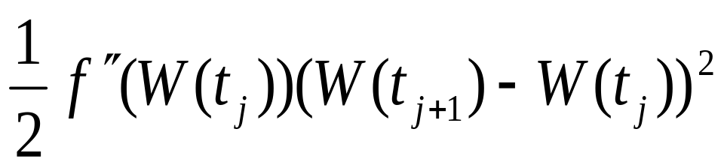
Remark 4.4.2
The first-order approximation, which is f’(W(t_{j}))(W(t_{j+1})-W(t_{j})), has an error due to the convexity of the function f(x).
Most of this error is removed by adding in the second-order term
,which captures the curvature of the function f(x) at x=W(t_{j})

Slide 24
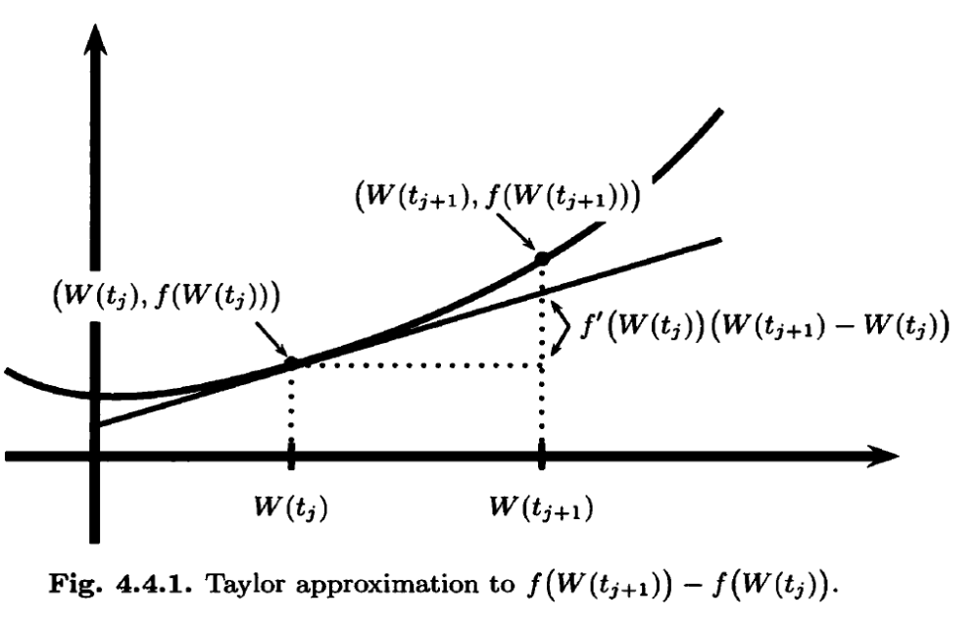

Fig. 4.4.1
Fig. 4.4.1 Taylor approximation to f(W(t_{j+1}))-f(W(t_{j}))

Slide 25
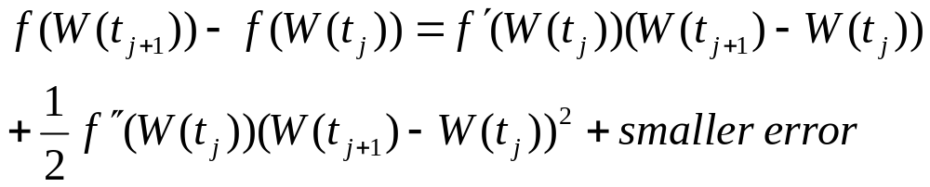
Remark 4.4.2
In other words,
(4.4.14)
And
(4.4.15)
In both (4.4.14) and (4.4.15), as ||∏||→0, the errors approach zero.

Slide 26
Remark 4.4.2
When we sum both sides of (4.4.14), the errors accumulate, and although the error in each summand approaches zero as ||∏||→0, the sum of the errors does not.
When we use the more accurate approximation (4.4.15), this does not happen; the limit of the sum of the smaller errors is zero.
We need the extra accuracy of (4.4.15) because the paths of Brownian motion are so volatile (i.e., they have nonzero quadratic variation).
This extra term makes stochastic calculus different from ordinary calculus.

Slide 27
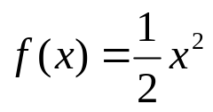
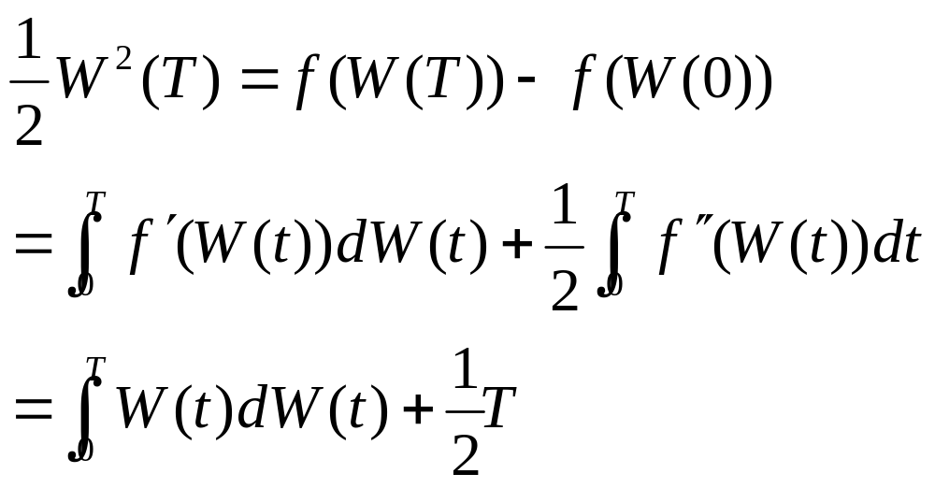
Remark 4.4.2
The Itô-Doeblin formula often simplifies the computation of Itô Integrals. For example, with this formula says that

Slide 28
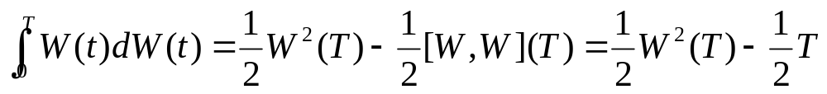
Rearranging terms, we have formula
(4.3.6)
and have obtained it without going through the approximation of the integrand by simple processes as we did in Example 4.3.2.

